Slide 1
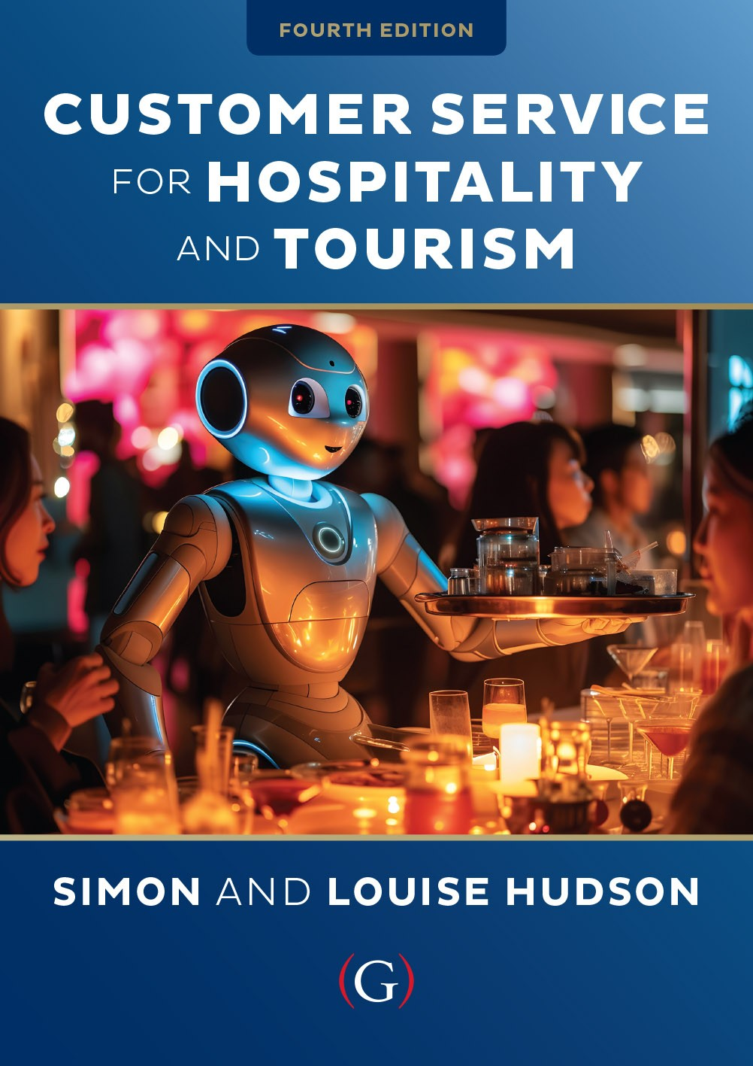
Chapter 12
Promoting customer service internally and externally

Slide 2
Topics Covered
Communication strategies
Approaches to service promises
Managing service promises
Ethical issues in communication

Slide 3
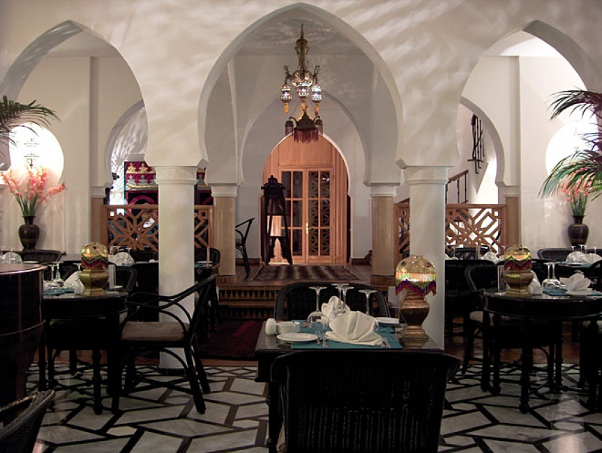
‘At Your Service’ Spotlight:
Serving up a dream in Casablanca
Rick’s Café Casablanca is a ritzy restaurant, bar and café located in the city of Casablanca, Morocco.
Designed to recreate the bar made famous by Humphrey Bogart and Ingrid Bergman in the movie classic Casablanca.
Customers don’t necessarily come for the food. “They come for the theme. They come for the dream. It’s a fantasy for some people. It means so much to them to be here.”
Rick’s Café is always looking at ways to improve customer service, and this requires investment

Slide 4
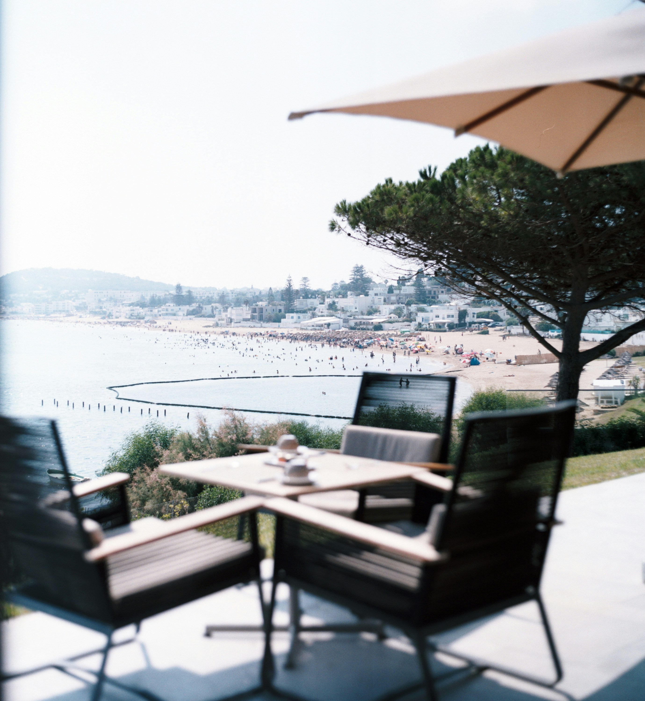
Integrated communication strategies for customer service
The worst mistake a business can make is to over-promise and under-deliver.
Managing communications and expectations
  Integrated marketing communications (IMC)
  Consistent, persuasive message
  Coordinated message and sources of communication
Branding increasingly important
  Create unique identity
  Impart meaning beyond functional roles
Steps for brand building:
  Analysis of market situation
  Development of brand identity
  Communication of brand vision
  Evaluation of brand’s performance

Slide 5
Approaches to service promises
Figure 11.1 (Source: Based on Zeithaml et al, 2007)

Slide 6

Managing service promises
Create effective service advertising
Coordinate external communication
  Unify communications tools, corporate and brand messages
  Consistent, persuasive message to target audiences
Make realistic promises
  Accurately reflect what customers will receive
  Effective internal communication in an organization
Communications tools may include:
  Interactive websites
  International conferences
  Awards and third-party endorsements
  Publicity stunts
  Short, online films
  Reality shows e.g. ‘Can You Serve?’

Slide 7
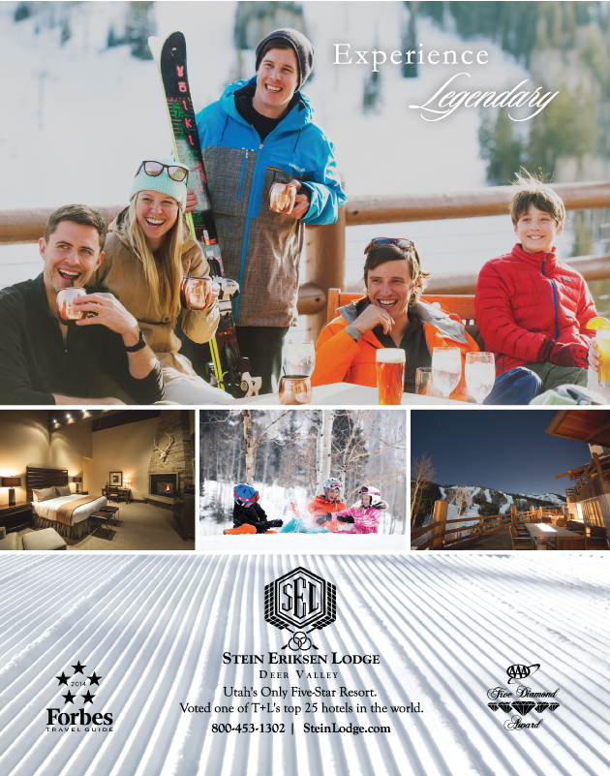
Managing service promises - continued
Image uses a mixture of both rational appeals (hotel room features), and emotional appeals (skiers enjoying the après ski).

Slide 8
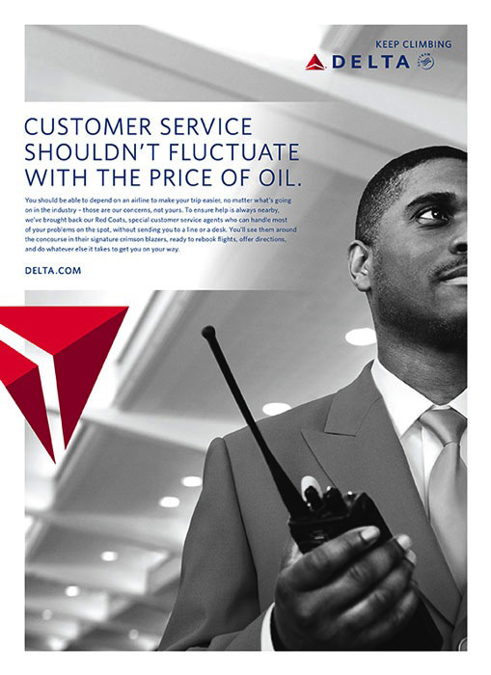
Managing service promises - continued
Use of employees to establish reliability, perceptions of quality

Slide 9
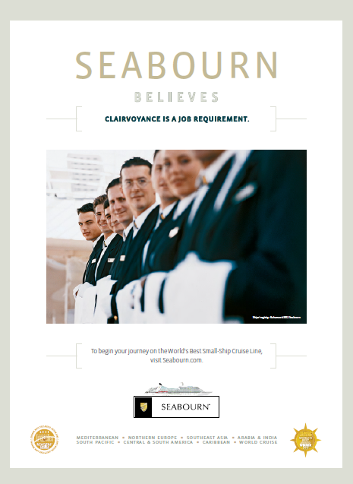
Managing service promises - continued
Employees portrayed as anticipating wants and needs

Slide 10
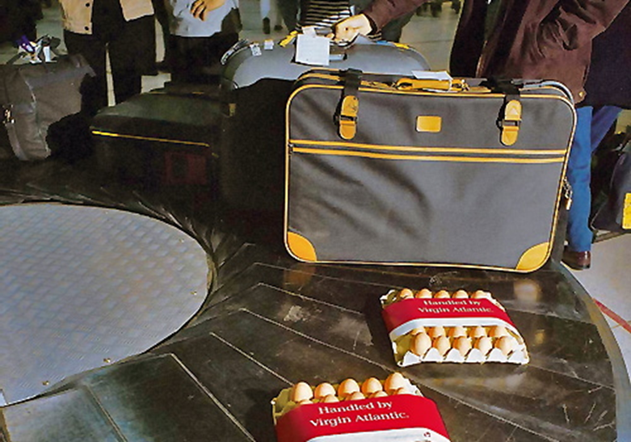
Managing service promises - continued
Stunts can generate much-needed publicity

Slide 11
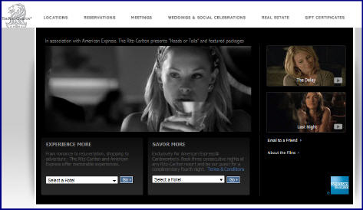
Managing service promises - continued
Branded entertainment, short online films

Slide 12
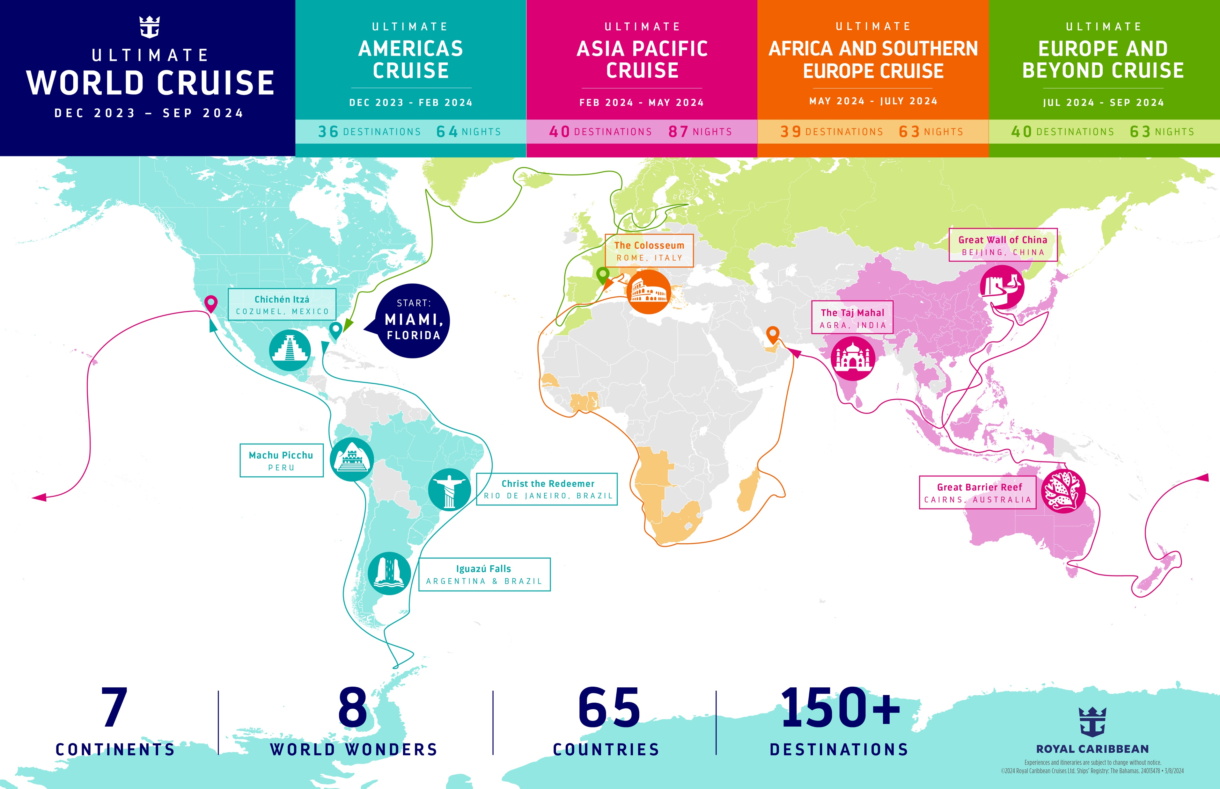
Service Snapshot: Royal Caribbean’s ‘Ultimate World Cruise’: The TikTok reality show
Royal Caribbean’s “Ultimate World Cruise” quickly became a viral social media sensation.
Within three weeks of the Serenade of the Seas setting sail, the #ultimateworldcruise hashtag was not only trending but had more than 150 million views on TikTok, skyrocketing the voyage to international awareness.
TikTok posts included the accounts of more than two dozen “cruise influencers” on board, as well as a handful of content creators
“It’s been fun to kind of just follow what truly feels like a TikTok reality show”

Slide 13
Ethical issues in communication
Potential misuse of advertising
Internet descriptions and photos
Product placements not labeled as advertisements
Promoting ethical stance can be good business as it potentially enhances a company’s profits, management effectiveness, public image and employee relations
During the COVID-19 pandemic, hitting the correct ethical tone with communications was critical.

Slide 14
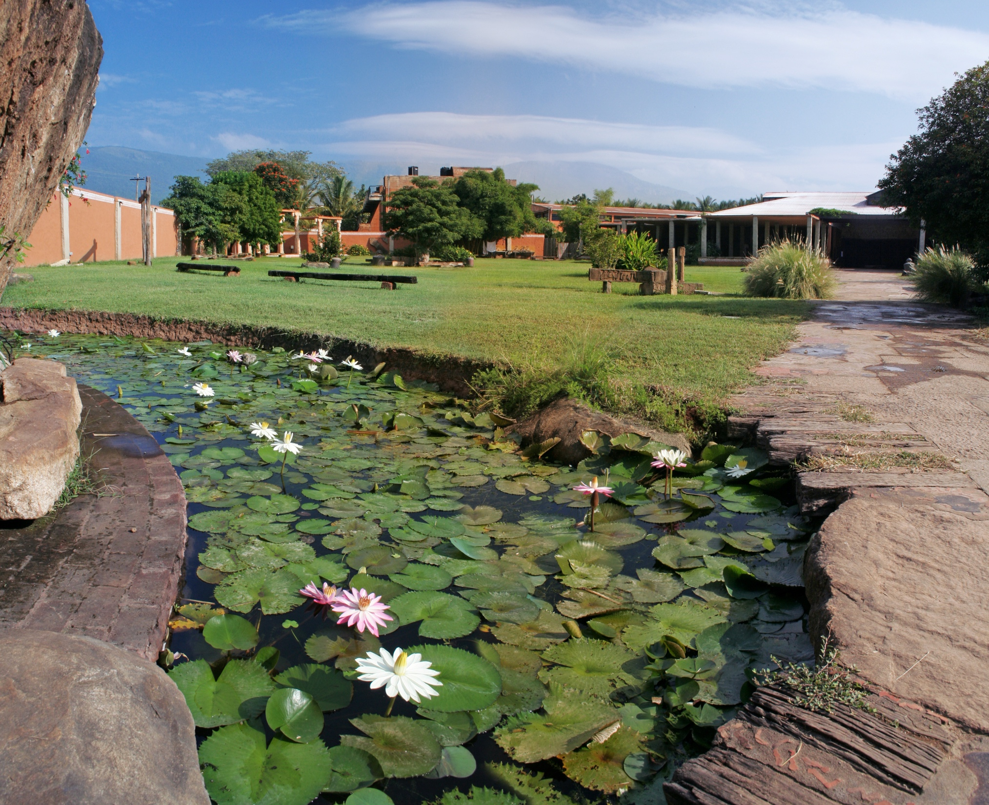
Case Study: Promoting the spirit of India
Isha Yoga Center is the brainchild of Sadhguru
Attracts thousands of visitors from all over the world
Offers all four major paths of yoga
Also the location for major cultural events
Portfolio of product offerings
  Isha Sacred Walks
  Sounds of Isha
  Isha Craft
  Isha Arogya
All promoted via an integrated marketing campaign

